Slide 1
Thriving in Medicine…Despite Everything… (Medical Association of Southeast Louisiana 10.6.2022)
Michael F Myers, MD
Professor of Clinical Psychiatry
SUNY Downstate Health Sciences University
Brooklyn, NY

Slide 2
Disclosure slide
Nothing to disclose
No conflicts of interest

Slide 3
Some experiential backstory
My room-mate Bill killed himself in 1963, we were both first year medical students
His death, and that of a fellow intern to suicide in 1967, propelled my pursuit of physician health
I treated my first MD patient in 1970 and then more than 700 in my private practice and scores more in consultation
Being a doctors’ doctor has been an awesome privilege, with many gifts, like courage, advocacy, humility

Slide 4
Recent news..

Slide 5
NY Times September 30, 2022

Slide 6
The sad story of Dr Stone
Dr Stone, a fifty-six-year-old internist, came to see me within days of being named in a lawsuit…..
Myers MF Why Physicians Die by Suicide: Lessons Learned From Their Families and Others Who Cared. Createspace Amazon. New York. 2017. p 31

Slide 7
Let me share what I’ve learned
From doctors who have never felt burned out
From my colleagues
From published literature
From my patients who have been there and revel in post-traumatic growth
From my own life’s journey

Slide 8
#1 Burnout can happen to anyone
Occupational in origin, it is systemic, not intrinsic to the individual
Changes are occurring in many institutions (of learning) and medical workplaces
Recognition of the price paid for toxic work sites
One of the main drivers is the notion of ‘making the business case for tackling burnout’
Go to site: National Academy of Medicine
Dr Lorna Breen Heroes Foundation

Slide 9
Introducing the Lorna Breen Law March 18, 2022

Slide 10
Corey Feist

Slide 11
#2 Resilience
Doctors are known to be some of the most resilient folks on the planet
Meaning – good problem-solving skills, sound judgment, cognitive savvy, ability to multi-task, ability to bounce back in the face of stress, good mood regulation
But resilience is not a fixed or static state – even the most resilient docs can be felled by overwhelming stress, but with help and time, will return to a steady state

Slide 12
#3 Burnout is not the same as depression
Overlapping symptoms
Unchecked burnout can co-exist with or lead to depression, PTSD, substance use disorders, anxiety and a host of interpersonal problems at work and home
Getting a consultation from a mental health professional is key and implementing effective Rx before things worsen lessens morbidity – and mortality

Slide 13
#4 Watch your agency
Loss of personal agency is one of the features of moral injury and then burnout
It’s imperative to speak up and make some major changes at work before you’re so used up and depleted that you’ve lost your voice
Get on a committee, fight for change
Talk with your boss, colleagues, friends, family members, a therapist about this
You may need to give yourself a timeline – if no change in x number of weeks/months, move on

Slide 14
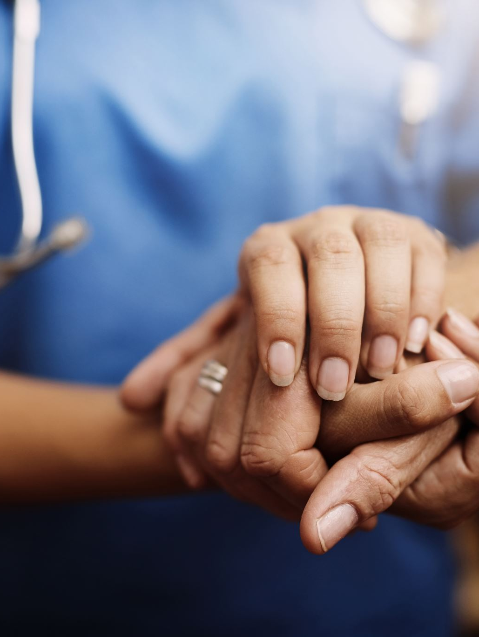
#5 Practice self-compassion
A new term in the physician health lexicon
Not to be confused with selfishness, self-centeredness, narcissism
Treat yourself with the same measure of kindness, time, attention, love that you give to others
The reward is renewal, a nicer disposition, and the loss of bitterness, martyrdom, and self-pity

Slide 15
# 6 Return to the basics of self-care
Rest
Sleep
Diet and nutrition
Exercise – personal trainer?
Hobbies
Protect time for yourself – guard with ferocity
Eastern philosophy and beyond – reading, meditation, yoga, tai chi, pilates

Slide 16
#7 Protect time for your family

Slide 17
# 7 Protect time for your family

Slide 18
# 8 Care for each other
No man is an island (John Donne)
We need each other in medicine, often more than we realize
Watch for any changes in a peer
Reach out
Listen and empathize and assist
You might save a life

Slide 19
#9 Religion and Spirituality
Whatever appeals and works for you
A departure from the responsibilities and demands of one’s medical work and career
Practice privately and/or communally in a house of worship
Benefits – appreciate the bigger picture of one’s life, stimulating, calming, comforting, guidance, inspiration, meeting new people, volunteering, giving back

Slide 20
# 10 Practice gratitude
“I cannot pretend I am without fear. But my predominant feeling is one of gratitude. I have loved and been loved; I have been given much and I have given something in return; I have read and traveled and thought and written. I have had an intercourse with the world, the special intercourse of writers and readers. Above all, I have been a sentient being, a thinking animal, on this beautiful planet, and that in itself has been an enormous privilege and adventure.”
Sacks, O Gratitude: Everything in Its Place. Knopf. NY. 2015

Slide 21
# 11 Psychotherapy
Why not? “Starting to see a therapist was the best thing I did during my residency” (reference: a chorus of residents/fellows/faculty from unpublished research Downstate)
Benefits = symptom relief, understanding oneself better, learning cues/triggers to watch for, gaining self-care skills, learning how to communicate more authentically and honestly, shedding guilt, building self-esteem, maturing personally and professionally

Slide 23
A nice story
A cardiac surgeon patient of mine, I’ll call him Dr Gore, now recovered from a devastating and crippling depression,…
Myers MF. Becoming a Doctors’ Doctor: A Memoir. KDP Amazon. New York. 2020, p 214.

Slide 24
Thank you!
And now, let’s turn to our illustrious panel for the next segment of the evening……..

